Slide 1
WildCatter - GITC 2022
Team Cumulus
Sri – Jnana – Babita

Slide 2
Objective
Create a Reinforcement Learning Agent to automatically place the wells to maximize the value and avoid faults/other structures.

Slide 3
Wish list for this competition
Tasks
Drill multiple wells, one after the other and not to update the environment after every simulation.
Make sure well/wells dont crash into each other/itself or any faults/artifacts
Avoid 180 degree turns
Have a target zone where the well eventually want to make it to and get higher reward
Use a metric like MSE/UCS to get an estimate on the amount of energy required to drill and optimizing it to have lowest energy usage (also tie in the economic constraints)
Action Space
Surface Location ?? Pick it randomly or intentionally?
Number of wells to drill
Bit Movement
Up/Down/Left/Right
Angle

Slide 4
Wish list for this competition
Possible Rewards
While Drilling
Proximity to Reservoir (based on the percentage of Normalized TOC?) - *Positive Reward*
Proximity to Fault - *VERY HIGH Negative Reward*
Proximity to itself or other wells - *VERY HIGH Negative Reward*
Proximity to the possible depletion zone of an existing well - *VERY HIGH Negative Reward*
Remaining oil in the zone of the well - *High Positive Reward*
After Drilling
Total UCS/MSE it was drilled through - *Negative Reward based on the UCS total, can also relate it to a USD amount*
Total Well Length - *Negative Reward based on the pipe count, can also relate it to a USD amount*

Slide 5
Create an agent with ability to drill multiple wells
Create an environment which takes in the number of wells as part of the training with the same reward mechanics as the SimpleDriller environment
Added a soft reset whenever one of the well is completed
The agent gets an reward based on its individual action, it gets the incremental reward gained over the life of the agent when a well is finished
Surface location is randomly selected, with a simple logic to avoid repeating the same location within the episode
Trajectory is appended to a list after the well is drilled and this list is also checked to avoid crashing into pre-existing wells

Slide 6
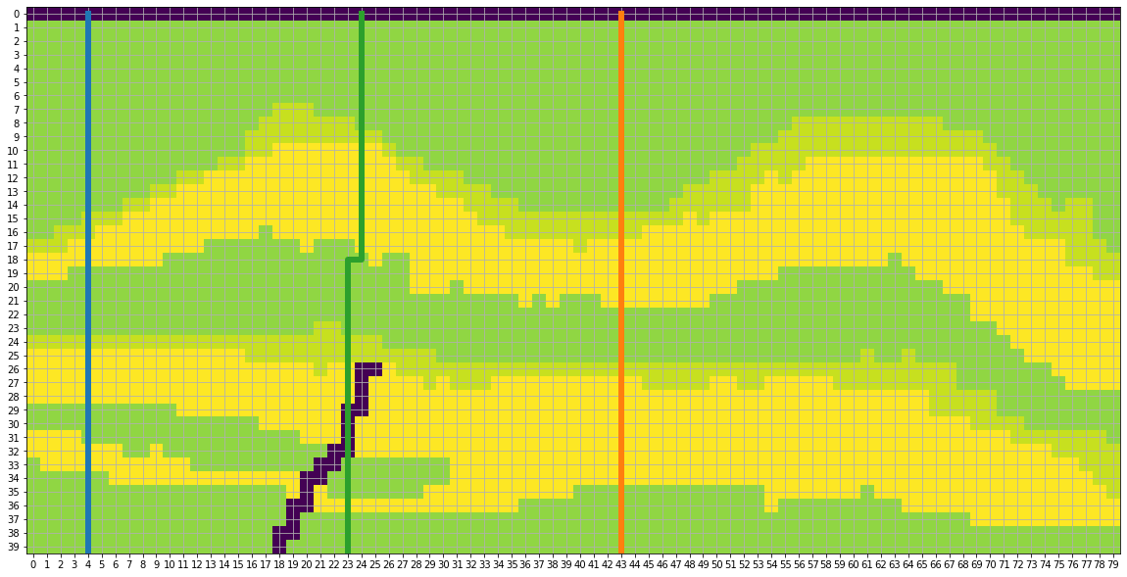
Testing the agent with 1 Episode and 3 Wells

Slide 7
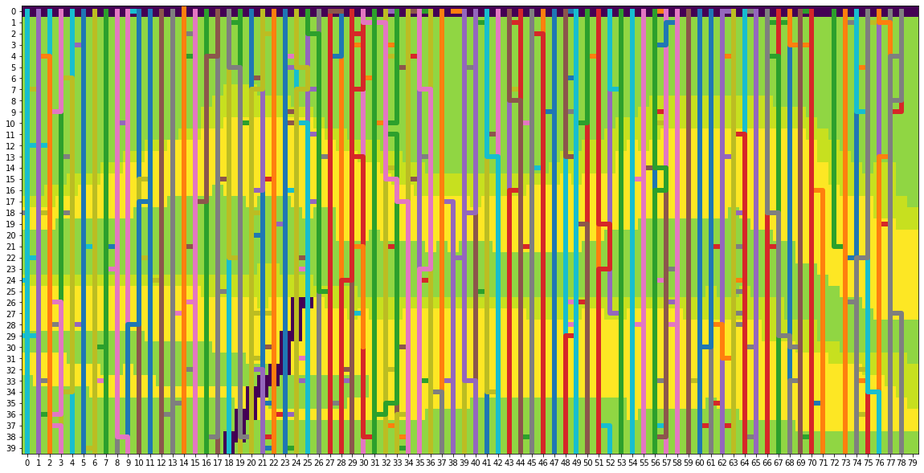
Testing the agent with 100 Episode and 3 Wells

Slide 8
Additional reward conditions to improve the agent
Added a condition to stop the well from crashing into faults
Added a condition to stop the wells to go along the surface horizontally
A small negative award based on the number of pipes to encourage the agent to take a short and efficient path while drilling
A negative reward for consecutive opposite actions (like left and then right)
Added a condition to only to finish the wells until a minimum number of pipes are reached (Also added a threshold to avoid infinite loop because of this minimum length condition)

Slide 9
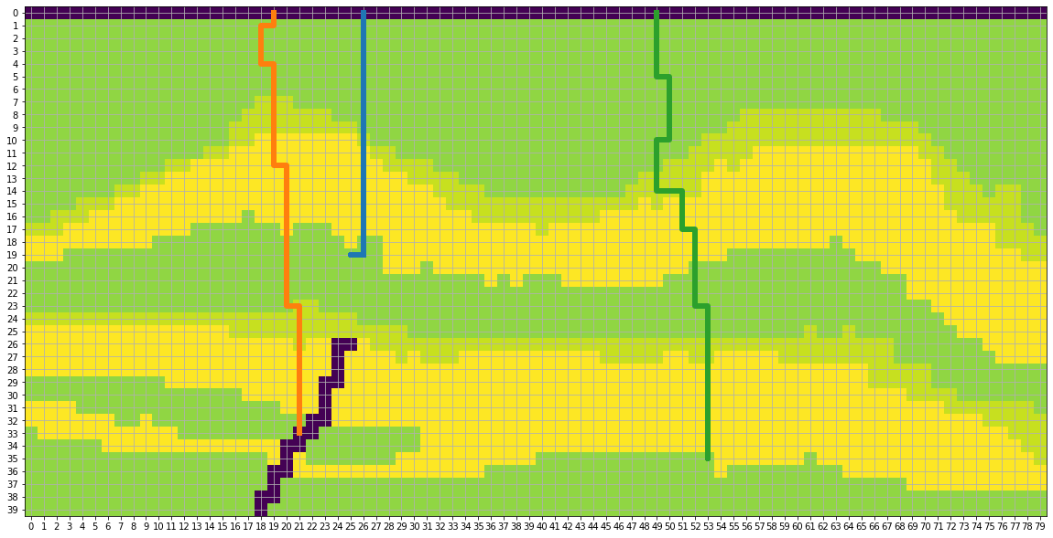
Testing the agent with 1 Episode and 3 Wells

Slide 10
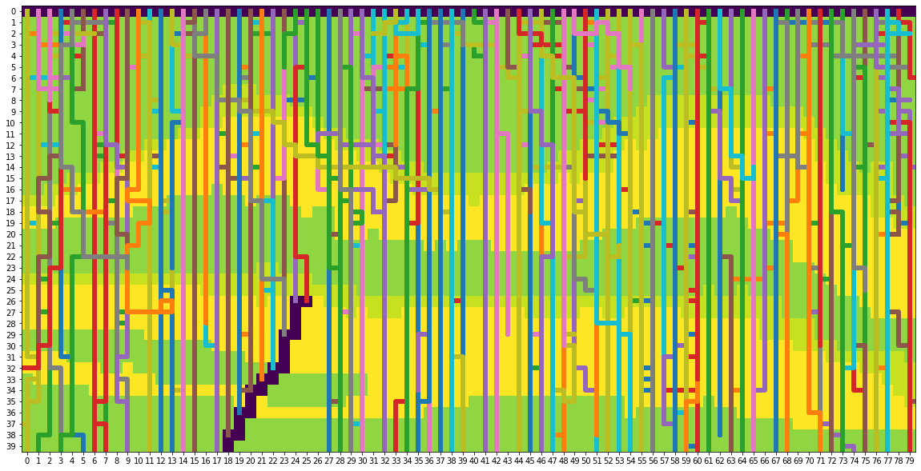
Testing the agent with 100 Episode and 3 Wells

Slide 11
Create an agent with the ability to drill horizontal well
We thought of horizontal well drilling as a version of maze solving or shortest path problem
Using Q learning and training the agent to create a reward table of all the possible states and moves will give the agent the ability to identify the best route to maximize the reward
For Q training, the following system was used
Get the surface location randomly
Get the possible valid actions at current location abiding the following conditions.
Avoid the well to turn back on itself
Remove the actions that will take the agent out of bounds
Force the well to go down from surface as the first move
Avoid “up” action, if it is going to hit the surface
Get Next action using Epsilon greedy algorithm

Slide 12
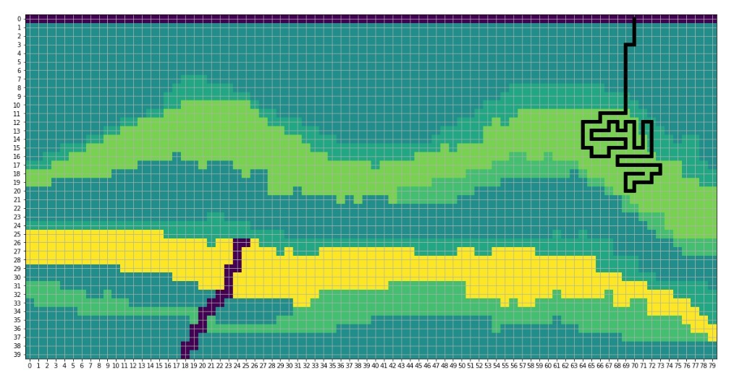
Create an agent with the ability to drill horizontal well
Q training Continued
Get the reward
Reward from the model
Negative reward to maintain the shortest path
Positive reward based on the lateral distance from surface location to encourage horizontal movement
Negative rewards based on the amount of pipes left in the inventory
High negative reward to encourage the agent to visit unique rows and columns (This condition penalizes for looping in on itself as seen in the image)
Populate Q table and use it for prediction

Slide 13
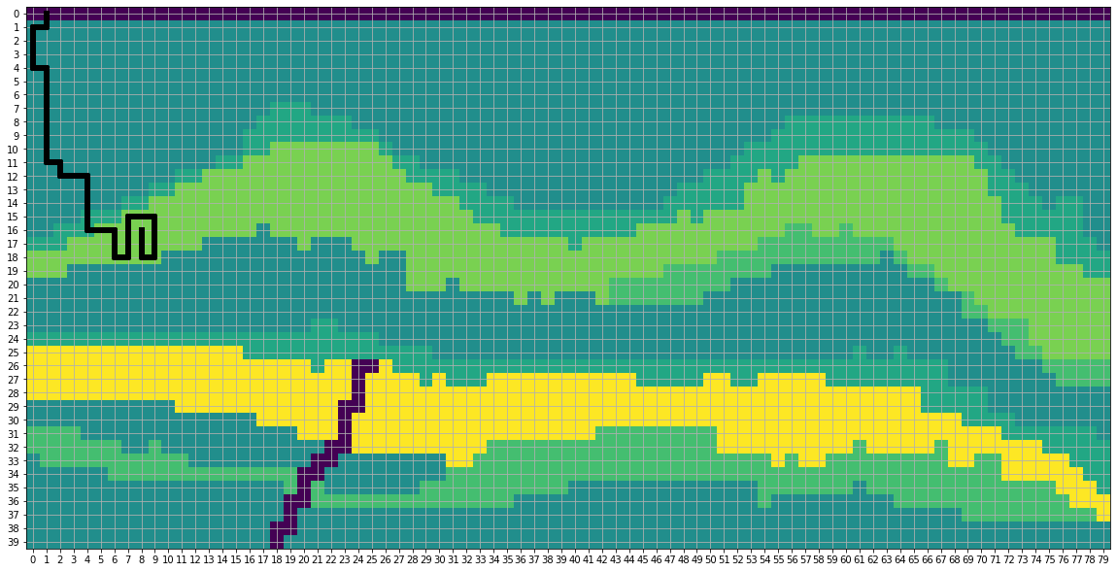
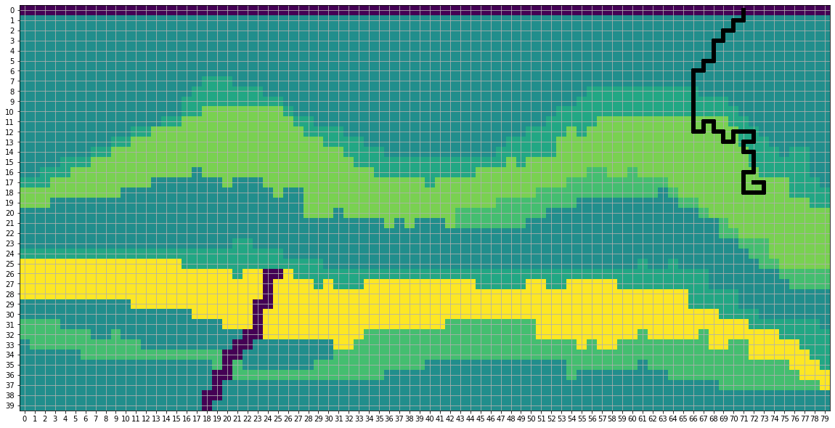
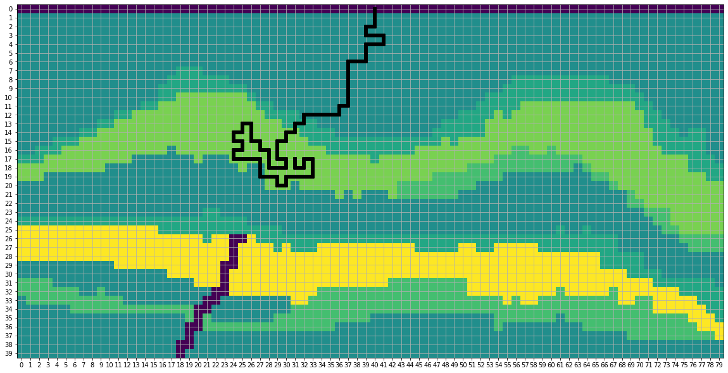
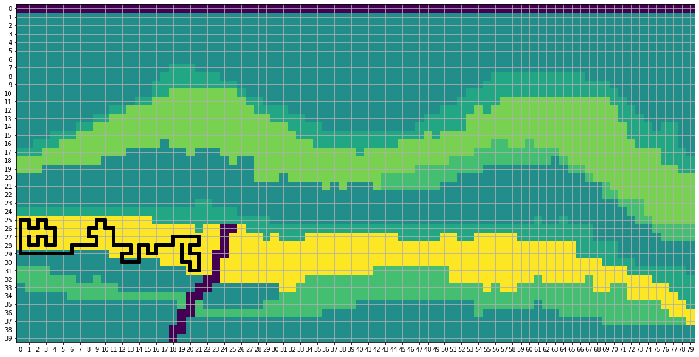

Slide 14
Results and Future Work
Reinforced Learning was used to
Drill multiple wells which can avoid faults and direct away from preexisting wells
Place horizontal wells to maximize reward
Future Work
Everything from the wish list (like adding production/UCS for a more complex interactions)
Use Deep Q learning to create a better agent that places the lateral by identifying the underlying higher reward area and avoid spending time looping onto itself

Slide 15
Thank you!
This was a very informative and fun challenge to dip your feet in to RL.
- Team Cumulus

